Slide 1

Combine vs RxSwift
Notes:
Combine framework was presented at WWDC2019. This is an obvious competitor to RxSwift, which implements the reactive streams specification. Let’s talk about whether something changed in our lives.

Slide 2
What is Combine?
What is Reacting programming?
Reactive programming is a declarative programming paradigm concerned with data streams and the propagation of change.
The Combine framework provides a declarative Swift API for processing values over time
Notes:
The Combine framework provides a declarative Swift API for processing values over time. These values can represent many kinds of asynchronous events
Реактивне програмування — це парадигма програмування, побудована на потоках даних і розповсюдженні змін. Це означає, що у мовах програмування має бути можливість легко виразити статичні чи динамічні потоки даних, а реалізована модель виконання буде автоматично розсилати зміни через потік даних.
Наприклад, в імперативному програмуванні вираз, означає, що отримує результат виконання безпосередньо під час обчислення виразу, і потім, якщо значення і зміняться, це не впливатиме на вже обчислене значення .
Проте, в реактивному програмуванні значення буде автоматично оновлено за новими значеннями, що є протилежністю функційного програмування.
Сучасна програма електронної таблиці є прикладом реактивного програмування.

Slide 3
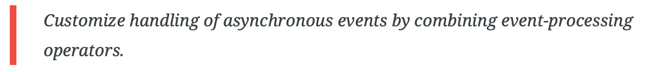
Apple describes the Combine framework as follows:

Slide 4
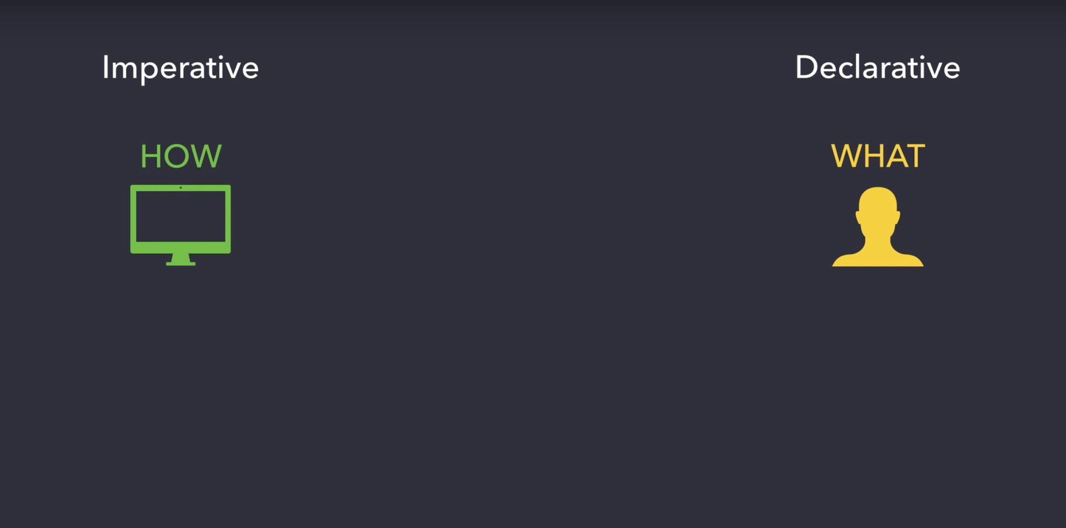
Notes:
Декларативне програмування — парадигма програмування, відповідно до якої, програма описує, який результат необхідно отримати, замість описання послідовності отримання цього результату.
Наприклад, веб-сторінки HTML — декларативні, оскільки вони описують, що містить сторінка та що має відображатись — заголовок, шрифт, текст, зображення — але не містить інструкцій як її слід відображати.
Ця парадигма мов програмування відмінна від імперативних мов програмування, таких як, наприклад, Фортран, C і Java, які вимагають від розробника детального описання алгоритму отримання результатів.
Стисло кажучи, для отримання результатів імперативні програми явно конкретизують алгоритм, а декларативні — явно конкретизують мету і залишають реалізацію алгоритму на допоміжному програмному забезпеченню (наприклад, інструкція вибірки SQL конкретизує властивості даних, які слід отримати від бази даних, але не процес отримання цих даних).
Відповідно до іншого визначення, програма «декларативна», якщо її написано винятково функціональною мовою програмування, логічною мовою програмування, або мовою обмежень. Назва «Декларативна мова» іноді використовується, щоб згрупувати всі ці мови програмування та протиставити їх імперативним мовам програмування.
Ці два визначення частково перекриваються. Зокрема, програмування обмеженнями і, меншою мірою, логічне програмування, зосереджуються на описі властивостей бажаного рішення (що), залишаючи невизначеним фактичний алгоритм, який необхідно використати для знаходження рішення (як). Проте, більшою мірою, мови логічного програмування, і, меншою, — мови обмеження, можуть описувати алгоритми і деталі реалізації, будучи таким чином не строго декларативними за першим визначенням.

Slide 5
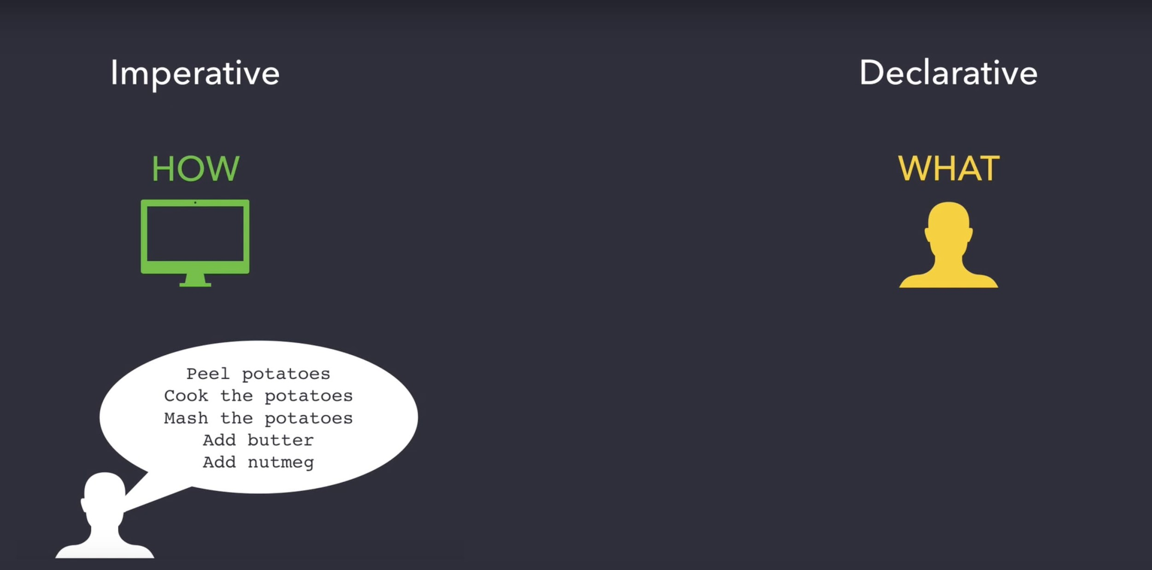

Slide 6
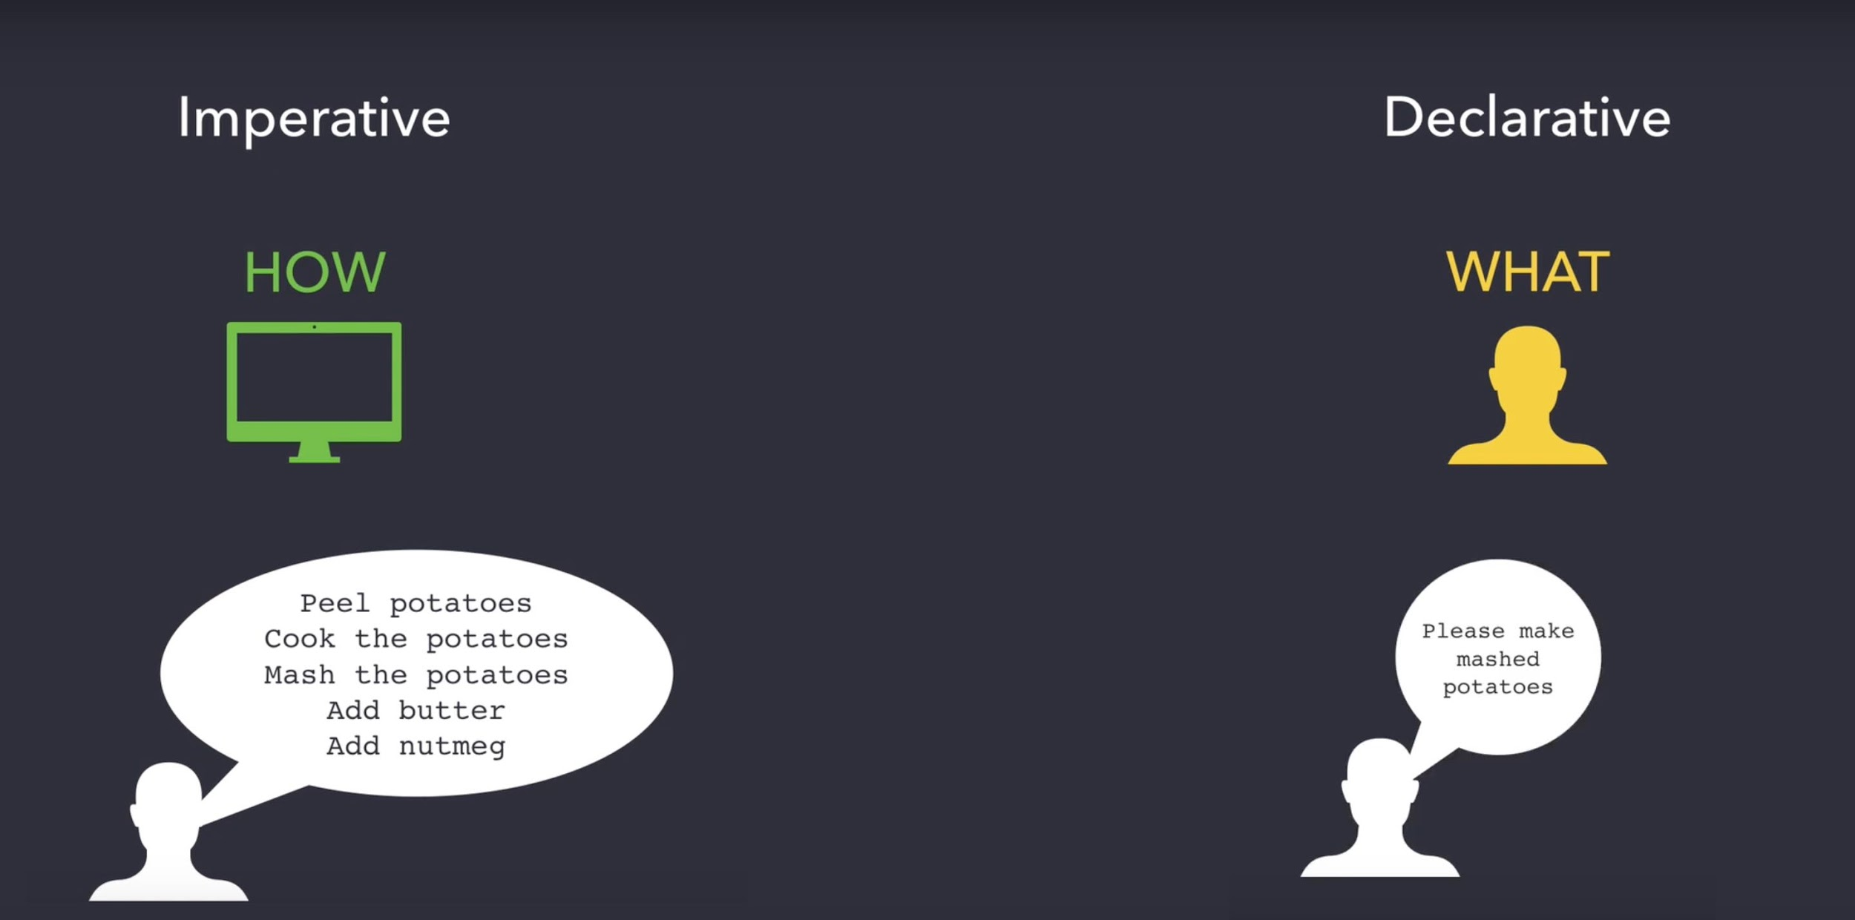

Slide 7




Key concepts
Combine
RxSwift
vs
Publisher
Subscriber
Observable
Observer
Notes:
We’ll start by highlighting Combine’s three main attributes
Generic.
Type safe.
Composition first.
Apple tells us in their Combine keynote that the main concepts are simple and easy to understand, but once combined they allow for more complex and interesting stuff to be done.
Within Combine we’ll find:
Publishers
Subscribers
Operators
Combine declares publishers to expose values that can change over time, and subscribers to receive those values from the publishers.
The Publisher protocol declares a type that can deliver a sequence of values over time. Publishers have operators to act on the values received from upstream publishers and republish them.
At the end of a chain of publishers, a Subscriber acts on elements as it receives them. Publishers only emit values when explicitly requested to do so by subscribers. This puts your subscriber code in control of how fast it receives events from the publishers it’s connected to.
И так для начала нам нужно кратко вспомнить, как взаимодействуют между собой фундаментальные части Combine, а именно Publisher, Subscription, Subscriber.
Subscriber присоединяется к Publisher'у
Publisher отправляет Subscription Subscriber'у
Subscriber запрашивает N значений у Subscription
Publisher отправляет N значений или меньше
Publisher отправляет сигнал о завершении
Two key concepts are the Observable and the Observer.
An Observable emits notifications of change.
An Observer subscribes to an Observable and gets notified when that Observable has changed.
You can have multiple Observers listening to an Observable. When the Observable changes, it will notify all its Observers.
Looking at these basic Combine concepts we can deduce that it is very similar to other existing reactive programming frameworks like RxSwift or ReactiveCocoa. For now, let’s focus on how it compares to RxSwift.
If you’re familiar with RxSwift you’ll notice that Publishers are basically Observables and Subscribers are Observers; they have different names but work the same way. A Publisherexposes values that can change and a Subscriber “subscribes” so it can receive all these changes.
Every Observable sequence is just a sequence. The key advantage for an Observable vs Swift's Sequence is that it can also receive elements asynchronously. This is the kernel of RxSwift, documentation from here is about ways that we expand on that idea.
Observable(ObservableType) is equivalent to Sequence
ObservableType.subscribe method is equivalent to Sequence.makeIterator method.
Observer (callback) needs to be passed to ObservableType.subscribe method to receive sequence elements instead of calling next() on the returned iterator.

Slide 8
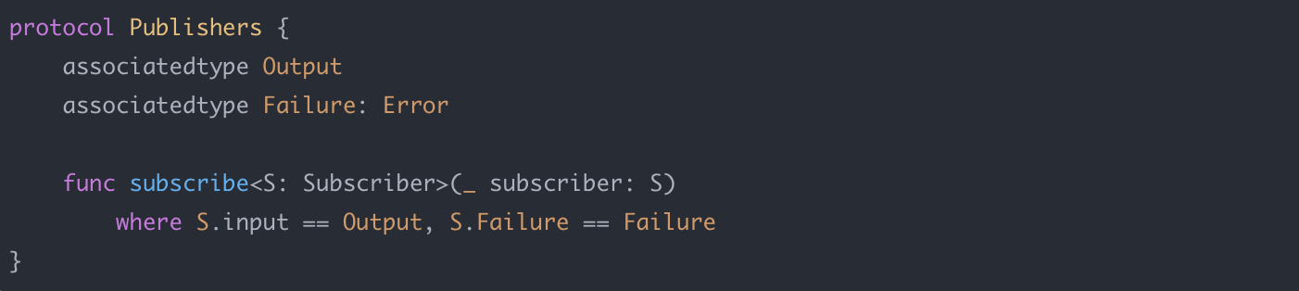
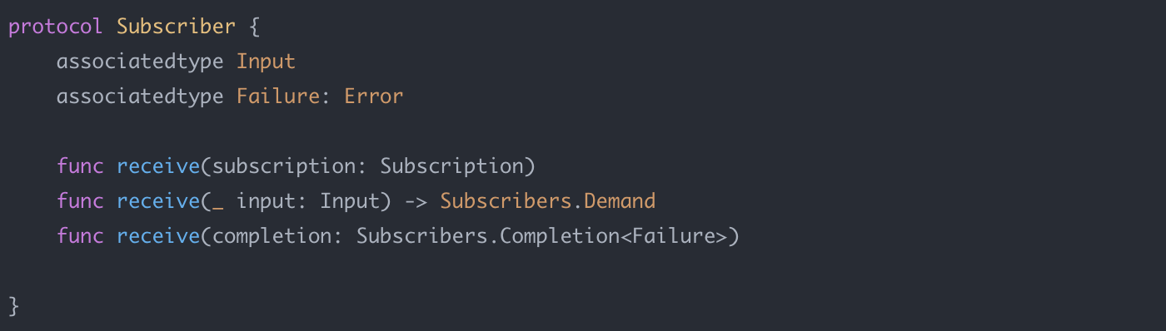
Notes:
Publishers
Publishers are the most declarative part of Combine’s API. They define how values and errors are produced.
They’re Value type, in Swift, Structs.
Publishers allow the subscription of Subscribers, in turn letting us receive values once they’re emitted.
Subscribers
Subscribers are the other side of the publishers coin. They receive values through the stream, and since these can mutate they are Reference types, like classes.
Several Foundation types expose their functionality through publishers, including Timer, NotificationCenter, and URLSession. Combine also provides a built-in publisher for any property that’s compliant with Key-Value Observing.
You can combine the output of multiple publishers and coordinate their interaction. For example, you can subscribe to updates from a text field’s publisher, and use the text to perform URL requests. You can then use another publisher to process the responses and use them to update your app.
By adopting Combine, you’ll make your code easier to read and maintain, by centralizing your event-processing code and eliminating troublesome techniques like nested closures and convention-based callbacks.

Slide 9
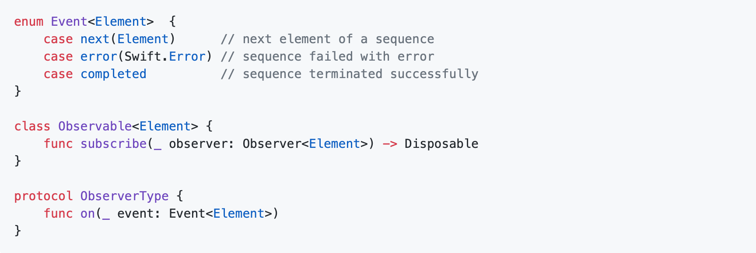
The equivalence of observer pattern (Observable<Element> sequence) and normal sequences (Sequence) is the most important thing to understand about Rx.
Notes:
The equivalence of observer pattern (Observable<Element> sequence) and normal sequences (Sequence) is the most important thing to understand about Rx.
Every Observable sequence is just a sequence. The key advantage for an Observable vs Swift's Sequence is that it can also receive elements asynchronously. This is the kernel of RxSwift, documentation from here is about ways that we expand on that idea.
Observable(ObservableType) is equivalent to Sequence
ObservableType.subscribe method is equivalent to Sequence.makeIterator method.
Observer (callback) needs to be passed to ObservableType.subscribe method to receive sequence elements instead of calling next() on the returned iterator.
Sequences are a simple, familiar concept that is easy to visualize.
People are creatures with huge visual cortexes. When we can visualize a concept easily, it's a lot easier to reason about it.
We can lift a lot of the cognitive load from trying to simulate event state machines inside every Rx operator onto high level operations over sequences.
If we don't use Rx but model asynchronous systems, that probably means our code is full of state machines and transient states that we need to simulate instead of abstracting away.
Lists and sequences are probably one of the first concepts mathematicians and programmers learn.
When a sequence sends the completed or error event all internal resources that compute sequence elements will be freed.
To cancel production of sequence elements and free resources immediately, call dispose on the returned subscription.
If a sequence terminates in finite time, not calling dispose or not using disposed(by: disposeBag) won't cause any permanent resource leaks. However, those resources will be used until the sequence completes, either by finishing production of elements or returning an error.
If a sequence does not terminate on its own, such as with a series of button taps, resources will be allocated permanently unless dispose is called manually, automatically inside of a disposeBag, with the takeUntil operator, or in some other way.
Using dispose bags or takeUntil operator is a robust way of making sure resources are cleaned up. We recommend using them in production even if the sequences will terminate in finite time.
Looking at these basic Combine concepts we can deduce that it is very similar to other existing reactive programming frameworks like RxSwift or ReactiveCocoa. For now, let’s focus on how it compares to RxSwift.
If you’re familiar with RxSwift you’ll notice that Publishers are basically Observables and Subscribers are Observers; they have different names but work the same way. A Publisherexposes values that can change and a Subscriber “subscribes” so it can receive all these changes.

Slide 10
Differences
Current compatibility
Error management
Operators
Open Source
UI Framework
Performance (look at the next slide)
Notes:
Current compatibility
First off, Combine does not offer backward compatibility, that is, it’s not available for systems older than iOS 13 / macOS Catalina, since it needs the new runtime process in order to work. There are no future plans to introduce this backward compatibility.
RxSwift works with iOS 8 and above.
Error management
Looking at the specification for the Observable protocol we’ll spot the first differences.
In Combine, every Publisher needs to specify an error type, while in RxSwift, Observablesdon’t use an error type, instead they can throw any type of error at any given moment. This makes RxSwift’s Observables easier to use, since you don’t have to think about the types of errors that should be launched. On the other hand, this means you’ll have to be careful when managing errors by yourself, since the compiler won’t help you if you missed one, something that wouldn’t happen with Combine since it’s way more strict.
With Combine, if your stream doesn’t throw errors of any kind you can mark it with the type Never.
While this explicit specification of error types can be seen as an extra layer of security, it also adds some complications to the code. Meanwhile, you can get something similar with RxSwift using the Result type, which adds an additional error type but your stream wouldn’t stop after throwing an error, or using a specific stream for error management.
There’s another difference regarding error management: Combine separates functions as throwing or non-throwing. For example, there’re operators that have an error-throwing version and the non-throwing one.
Combine and RxSwift have a lot of operators doing the same or a very similar job, but with a different naming.
An important element that we’ve mentioned before is that Combine is not an open source project, something pretty logic if we take into account that the rest of Apple frameworks aren’t either. It’s feasible that Combine uses system features only available to Apple developers, but even if it was open source, Apple would still have a bigger advantage when tackling potential problems related to their core.
Inside a reactive framework we need some way to link the reactive flows to the view, and vice versa. RxSwift’s solution is RxCocoa.
Combine doesn’t have a specific framework to do these binds, instead we can use the assignmethod to link a stream to a key path and a view property.
publisher.assign(to: \.text, on: label)
Combine (still) doesn’t have a way to obtain a stream from a UI component in the same way we can with RxCocoa.

Slide 11
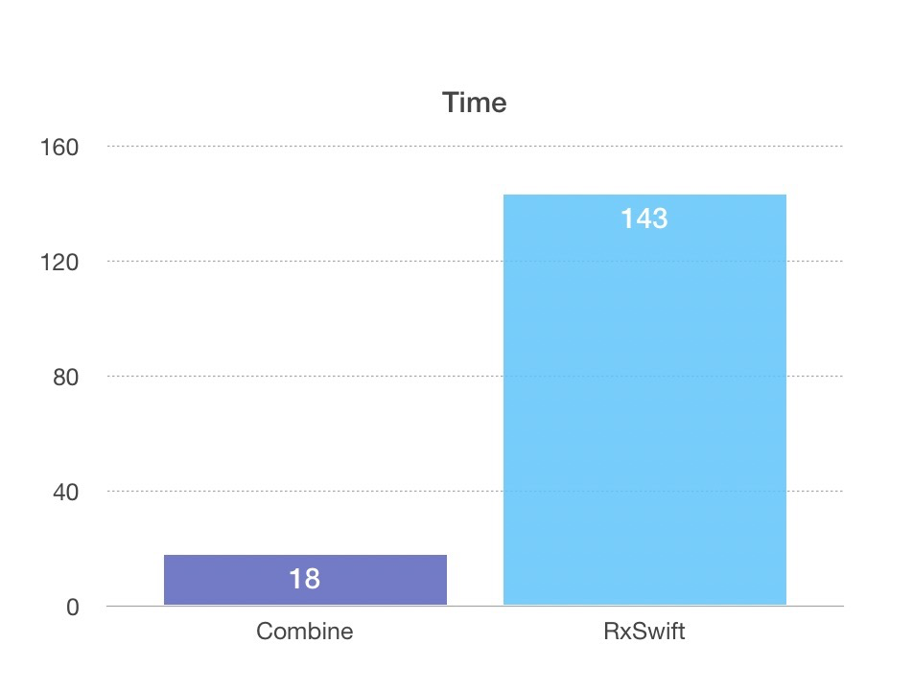
Performance
Notes:
Performance wise, and while it’s undeniable that RxSwift is a properly optimized framework, Combine has been built by Apple’s engineers with a 100% focus on performance.
As we can see on Flawless iOS blog, they did a comparison executing two code blocks doing the same work, one with Combine and the other with RxSwift, and we can observe that Combine’s time performance is the winner.
One of the main reasons for this improvement is because RxSwift uses Swift as its main language and thus needs to do a lot of sinks on the frameworks’ lower layers, affecting its performance. On the other hand, Combine is a Close Source project, and might not have necessarily been developed using Swift (but can expose a public Swift interface). Apple can use a lot of performance optimizations not available to developers outside of the company.

Slide 12
Example

